Slide 1
Coursera Capstone Project
Data Analysis and survey to get the best location for a proposed bookshop that will be located within the Neighborhood of Manhattan New York State, United States of America

Slide 2
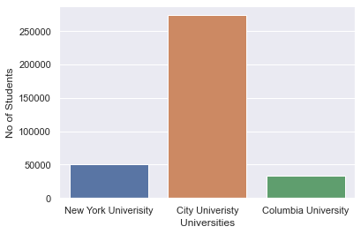
Bar plot showing the student population of New York, City and Columbia Univeristies

Slide 3
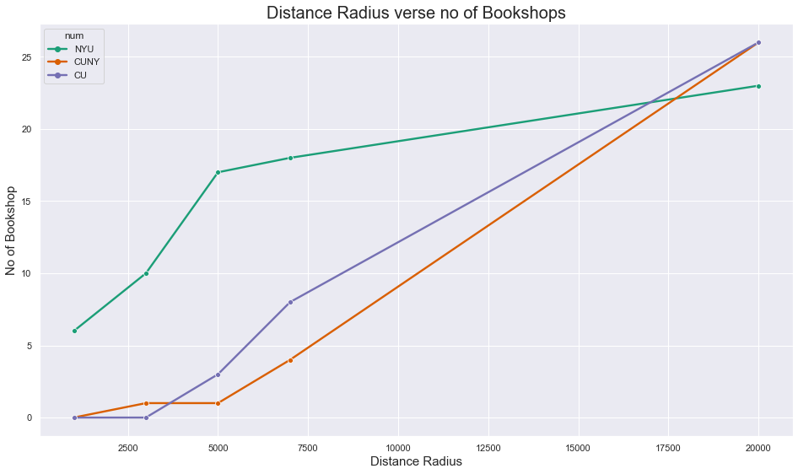

Slide 4
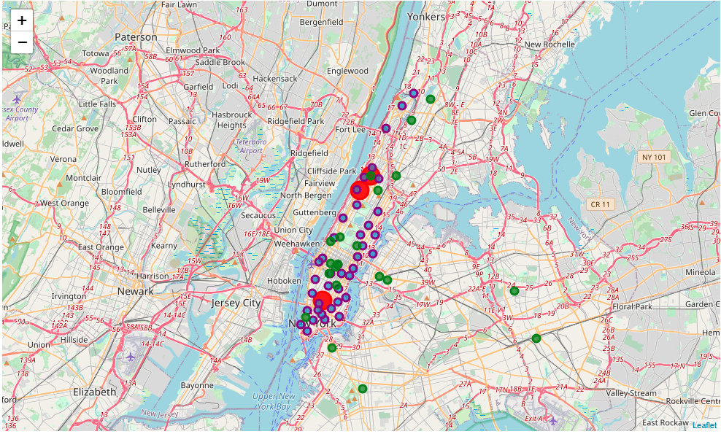
The location of the universities campuses in the neighborhood of Manhattan

Slide 6
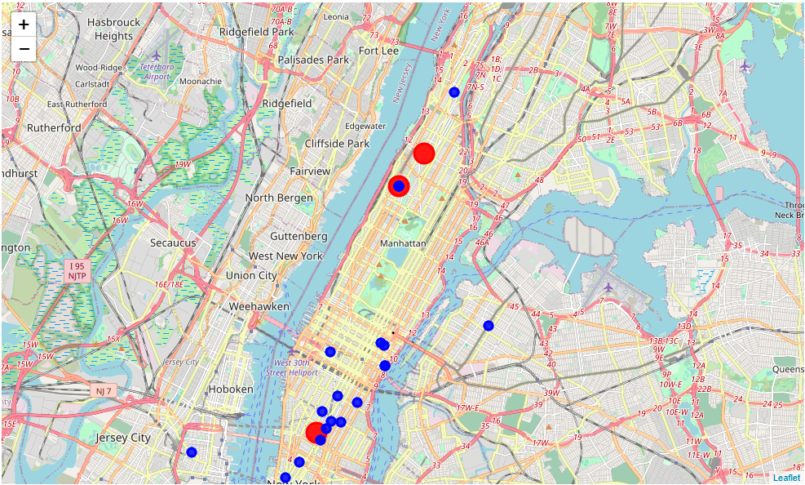
The location of the existing bookshops within the neighborhood of the three univeristies.

Slide 7
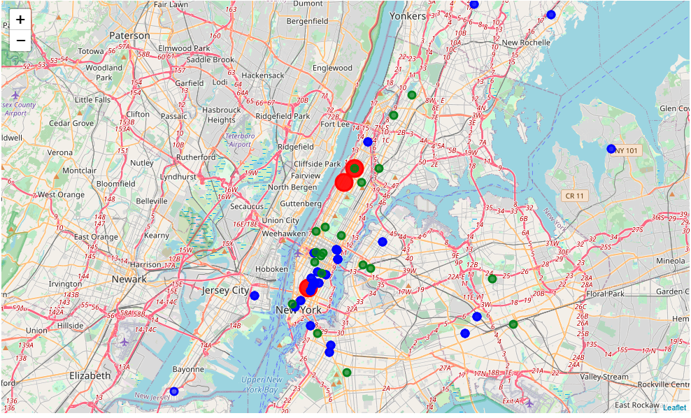
The location of the campuses and the existing bookshops

Slide 8
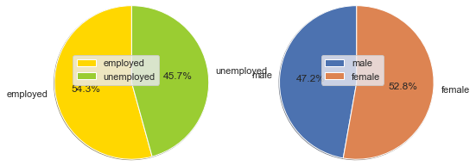
Plot of employment and sex status in Mahanttan borough New York

Slide 9
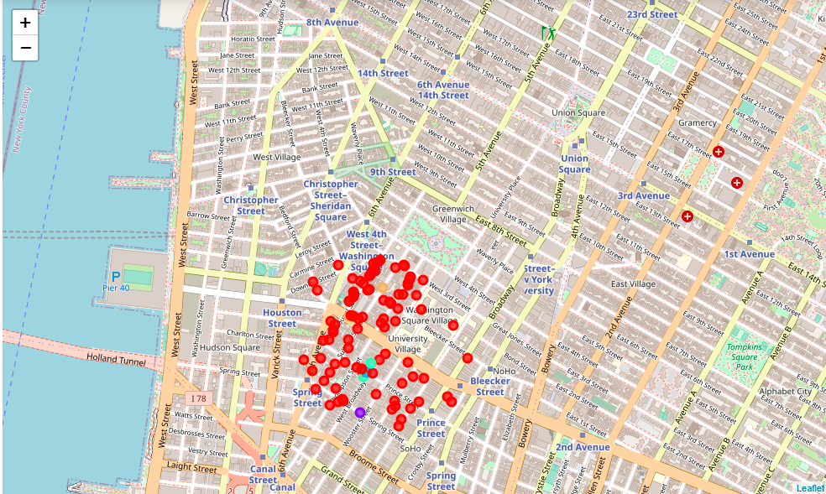
Cluster groups around the Greenwich neighborhood of Manhattan Borough

